Slide 1
Sneaker Sales Website
Group 5:
1753003-Nguyễn Phạm Quang Định
1753057-Phù Vĩnh Hùng
1753048-Phạm Khánh Duy
1653098-Võ Minh Tú

Slide 2
Table of Contents
Problem statement
Product position statement
Project management
Software requirements
Analysis and design
Software testing
Demo

Slide 3
I. Problem Statement
The problem of | Approach to all the sneaker sales
Affects | Teenagers and college students.
The impact of which is | That they are unable to looking for the sneaker sales without spending significant time searching on facebook and google.
A successful solution would be | Notify them when there are new sales for those sneakers that they are interested and provide them a place to get the sales they have requested.
Target users and environments
Target users: Target users: Our majority of customers are young people between
the ages of 15 and 25 who love sneakers and have access to the internet but the
budget is limited.
Environments: a website.

Slide 4
II. Product Position Statement
For | Teenagers and college students
Who | Want to approach to all the sneaker sales
The Sneaker Sales Website | Is a website
That | Notify them when there are new sales for those sneakers that they are interested.
Unlike | Other websites of online shoe stores that the customers need to check each website for their own sales product.
Our product | Notify them when there are new sales for those sneakers that they are interested, and provide them a place to get the sales they have requested.

Slide 5
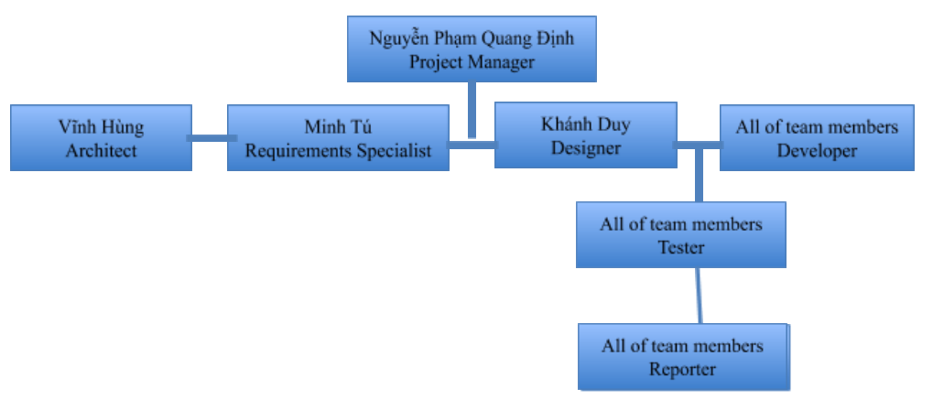
III. Project management 1.Organization structure

Slide 6
III. Project management 2. Roles and Responsibilities
Person | Role
Project Manager | The Project Manager allocates resources, shapes priorities, coordinates interactions with the customers and users, and generally tries to keep the project team focused on the right goal. The Project Manager also establishes a set of practices that ensure the integrity and quality of project artifacts. The project manager also join in each roles for supervision and assistance.
Architect | The Architect leads and coordinates technical activities and artifacts throughout the project. The Architect determines, provides and explain key components and the organization of these components to form the architecture. They need to form an architecture following a certain styles like MVC, n-tier, and microservices. How components are connected, which languages are used for each component are two questions that need to be answered by the architect.
Requirements Specialist | The requirements specialist is the one that finds and analyzes requirements of the project. They also have to determine and draw use-case models and specificate them into the project’s feature.

Slide 7
III. Project management 2. Roles and Responsibilities
Person | Role
Designer | The designer leads and coordinates the prototyping and design of the Web interface, by capturing requirements on the Web interface, including usability requirements, building Web page prototypes, involving other stakeholders of the Web interface, such as end-users, in usability reviews and use testing sessions, and reviewing and providing the appropriate feedback on the final implementation of the Web interface (as created by other developers, i.e. designers and implementers).
Software Engineer (Developer) | Responsibilities for coding and transferring the design into a real Website and help tester find and fix bugs after coding. May also provide assistance to other roles as necessary. The developer also design the database for system and implement them for compatibility with system which has been created as said above.
Tester | Responsibilities for testing the program of the website (use test cases have been made), finding bugs. May also provide assistance to other roles as necessary.
Reporter | Reporter must record the work done in a general and complete manner. They then write these into weekly reports.

Slide 8
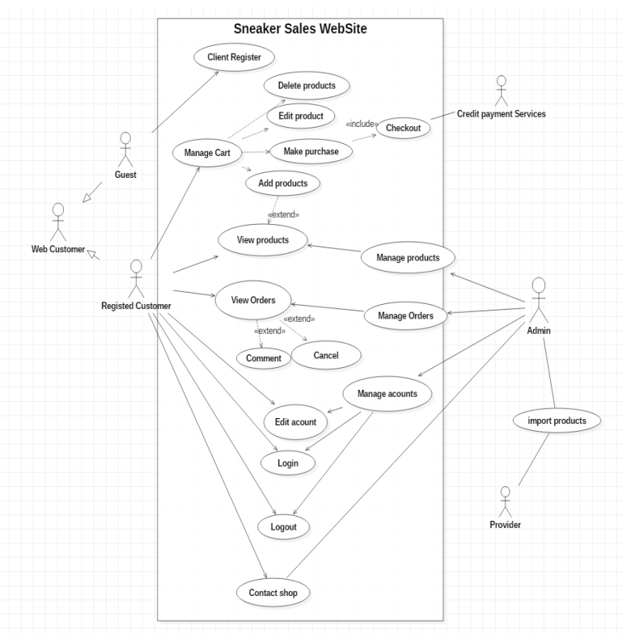
IV. Software Requirements

Slide 9
III. Software Requirements
Non-Functional Requirements
Name | Detail
Applicable standards | The website must comply with existing web standards (HTML, JAVA,TCP/IP, etc). The website must be accessible by multiple platforms (mobile, pc, etc).
System requirements | None specified
Performance Requirements | The website must be able to handle 2000 user at the same time. The website must handle the request quickly.
Environment Requirements | None specified

Slide 10
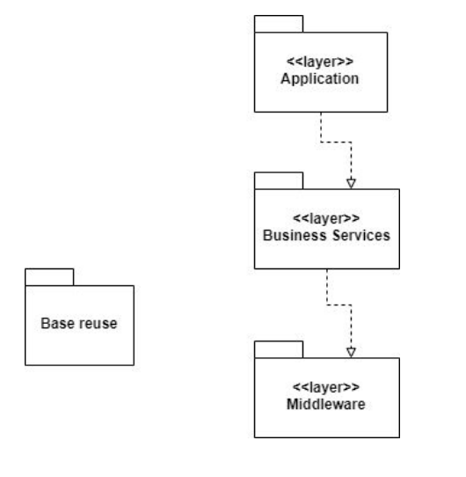
IV. Analysis and design
Logical View

Slide 11
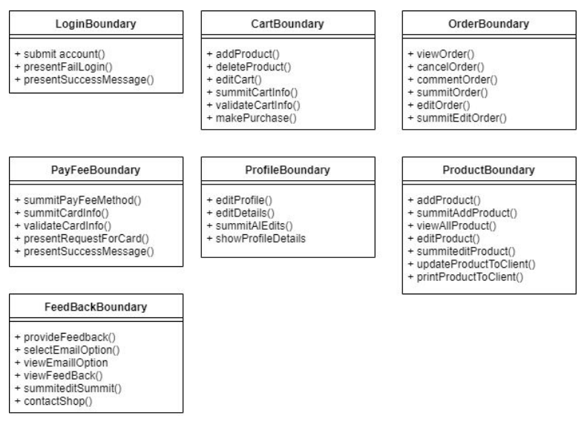
IV. Analysis and design
Application package

Slide 12
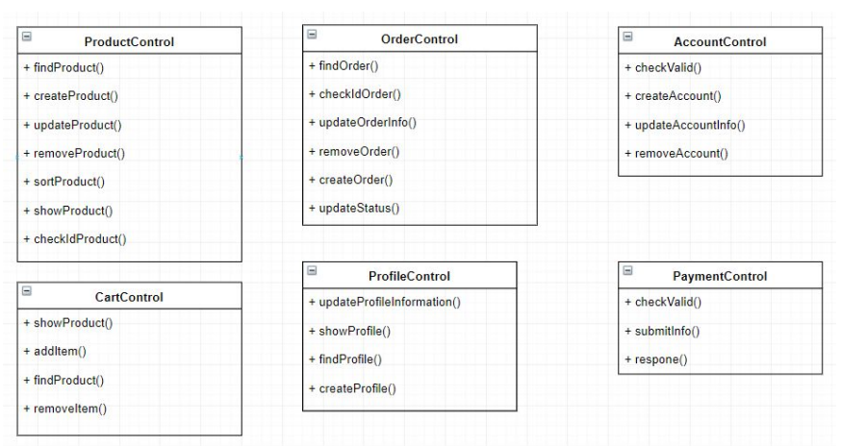
IV. Analysis and design
Business services

Slide 13
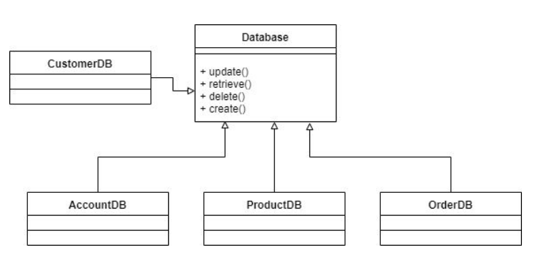
IV. Analysis and design
Middleware package

Slide 14

V. Software testing
Hardware Requirements
Laptops with a x86_64 CPU, 8Gb RAM, support Operating Systems that list in the section below.
Smartphone support at least iOS 12 and Android 9.
Required Internet Connection(Cable, Wifi or 4G LTE).
Database requires a midrange server with a x86_64 CPU and 8Gb of RAM, that we would use laptop for
convenient.
All hardware requirements, as stipulated in the Vision Document and Software architecture document
must be taken into consideration.

Slide 15
V. Software testing
Software in the Test Enviroment
Software Name | Purpose | Version | Type and Other Notes
iOS | Test website on iOS | 12.4 | Operating System
Android | Test website on Android | 9 | Operating System
Mac OS X | Test website on Max OSX | 10.14.6 | Operating System
Window 10,64 bit | Test website on Windows | 1909(lasted) | Operating System
PostgreSQL | Review Website database | 12.1(lasted) | Database
Firefox | Test website support Firefox | 70.0(lasted) | Internet Brower
Google Chrome | Test website support Google Chrome | 79(lasted) | Internet Brower

Slide 16
V. Software testing
Productivity and Support Tools
Tool Category or Type | Tool Brand Name | Vendor or In-house | Version
Defect Tracking | MS Excel 2010 | MS | 2010
Automated Test Tool | Katalon Studio | Katalon Studio | Lasted

Slide 17
V. Software testing
Database.
Verify access to Sneaker Sales Website Database.
Verify simultaneous record read accesses.
Verify correct retrieval of update of database data.
Functionality.
Verify that Login function work.
Verify that Search function return correct products.
Verify that Filter show the right products.
Verify that Customer can view and manage shopping cart.
Verify that Admin can manage the orders.
Verify that Check out and purchase work.
Usability.
Navigate through the website and verify that the website has a user friendly interface.
Verify that the website is clearly and easy to understand to use.
UI.
Verify that the website has a suitable layout.
Verify that the website has a good design:
Color pattern.
Image size and style.
Button and menu style and size.
Font type and size.
Compatibility.
Verify that the website work on varieties Internet Browser and Operating System.

Slide 18
V. Software testing
Test features
Summary
Bug report
ID | Feature name | Description | Remark
LI | Login | Use login page to log in as normal user
Fil | Product view filter | Filter sneakers at search result view (brand, color, sex, size, price)
AC | Add product to Cart | Add selected product to cart, view cart, edit cart
Features | Number of test case | Passed | Failed
1.Login | 5 | 5 | 0
2.Filter | 6 | 4 | 2
3.Add to Cart | 5 | 5 | 5
Defect ID | Defect Title | Defect Description | Function ID | Severity | Reported By | Date Reported | Status
B001 | Price Filter not working in search result view | Web page does not load the product when change price filters | Fil_5 | High | Nguyễn Phạm Quang Định | 12/22/2019 | Open
B002 | Sex Filter not working in search result view | Web page does not load the product when change sex filters | Fil_6 | High | Nguyễn Phạm Quang Định | 12/22/2018 | Open
B003 | Product image is missing | Many Product images is missing | Fil & AC | Low | Nguyễn Phạm Quang Định, Phù Vĩnh Hùng | 12/22/2018 | Open

Slide 19
VI. Demo
Login Page
Search result
View product details
Add to Cart
Manage Cart
Payment
View order list
Order detail

Slide 20
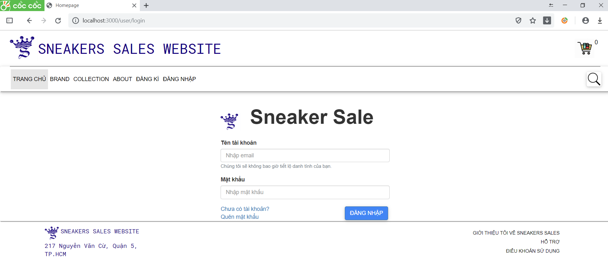
Login

Slide 21
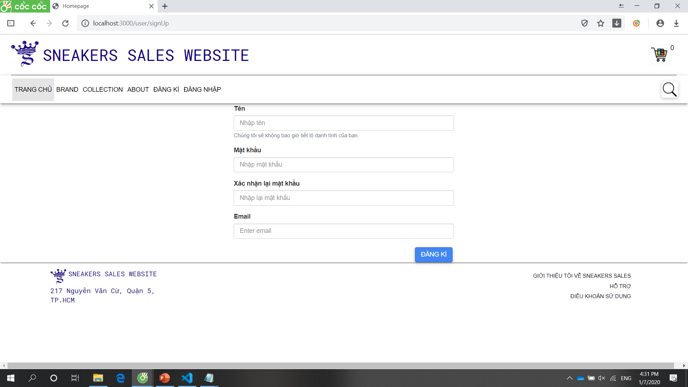
Register

Slide 22
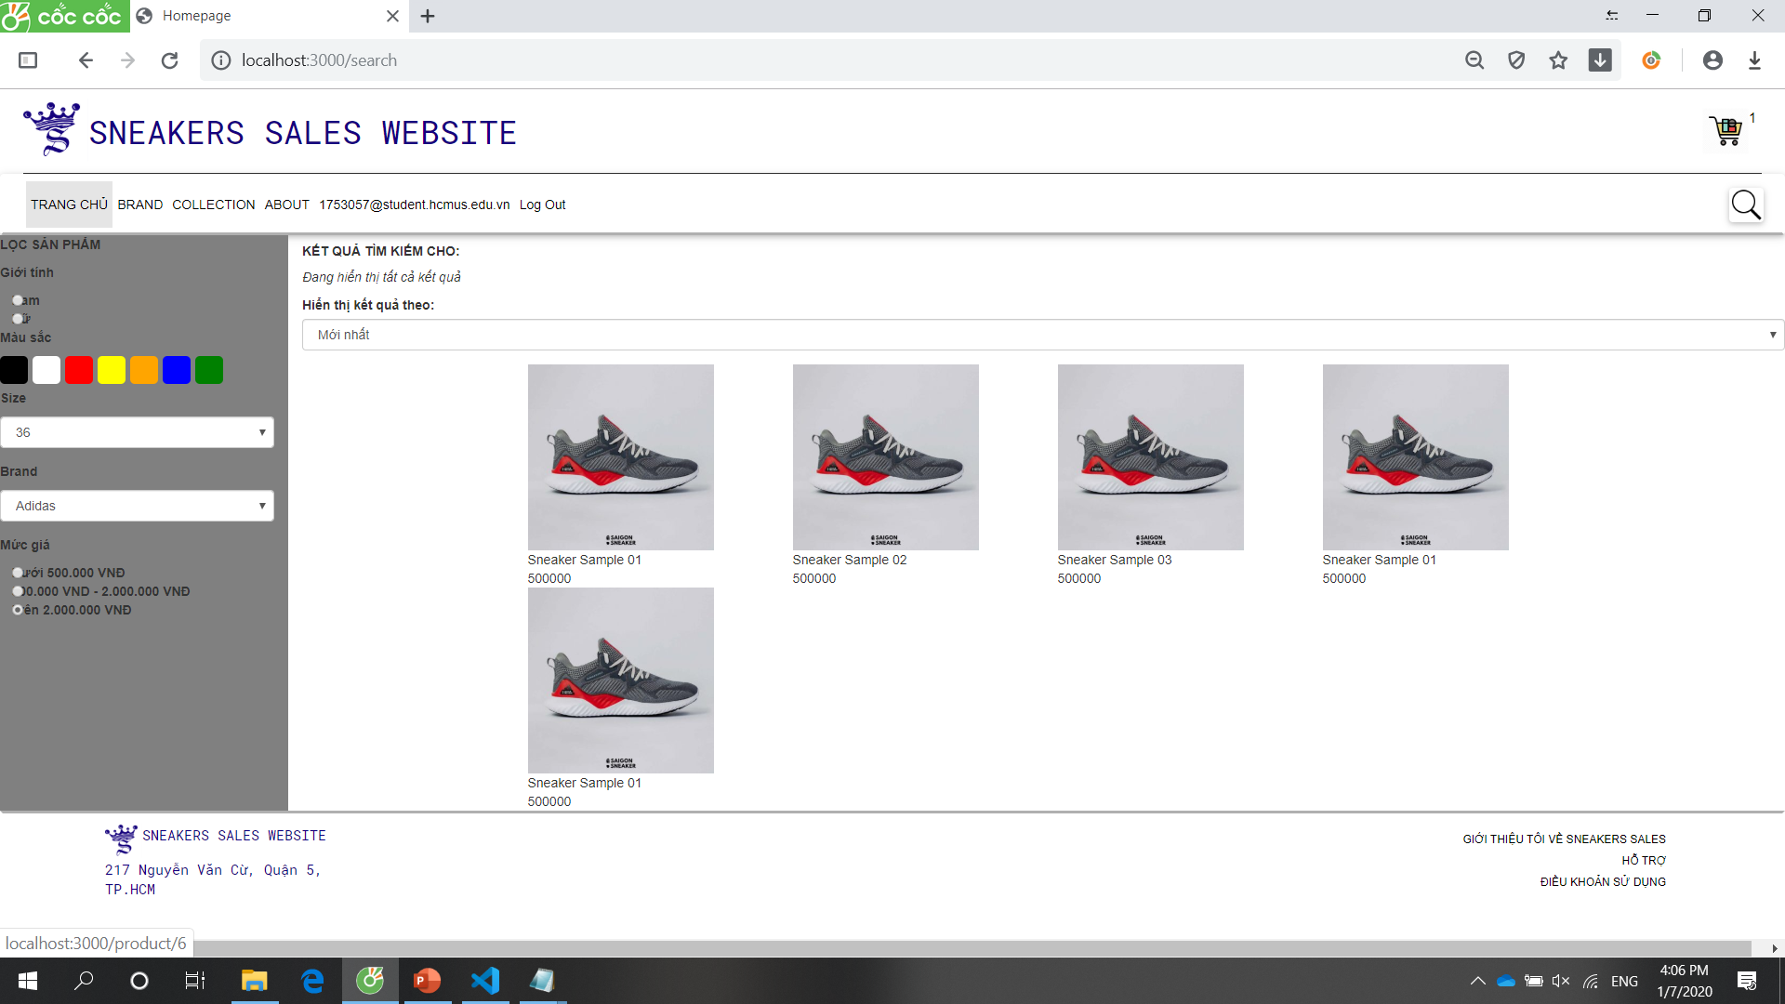
Search Result page

Slide 23
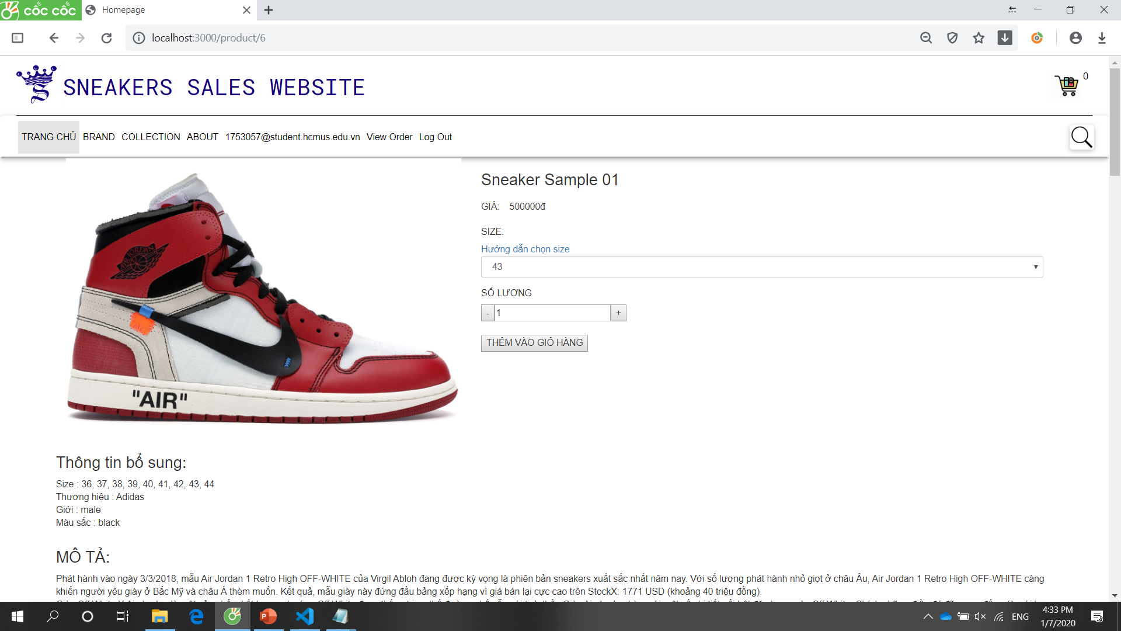
View Detail

Slide 24
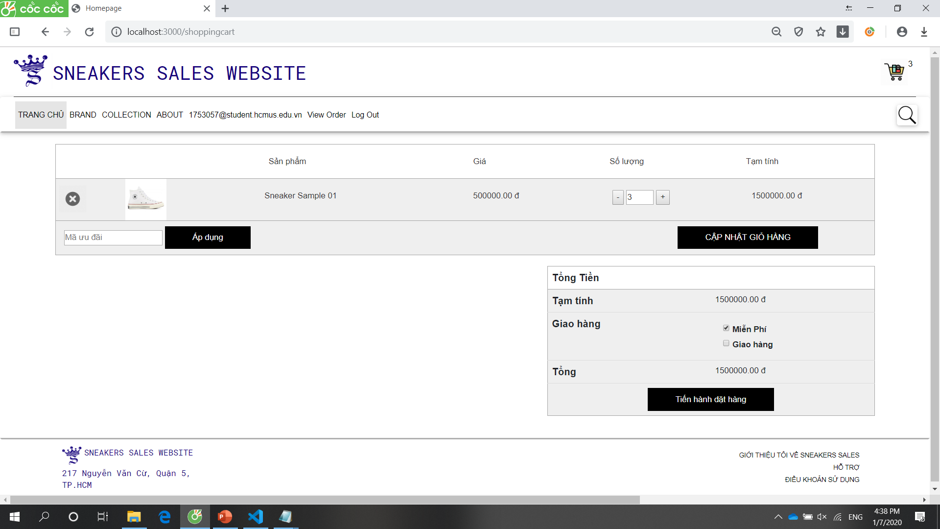
Cart

Slide 25
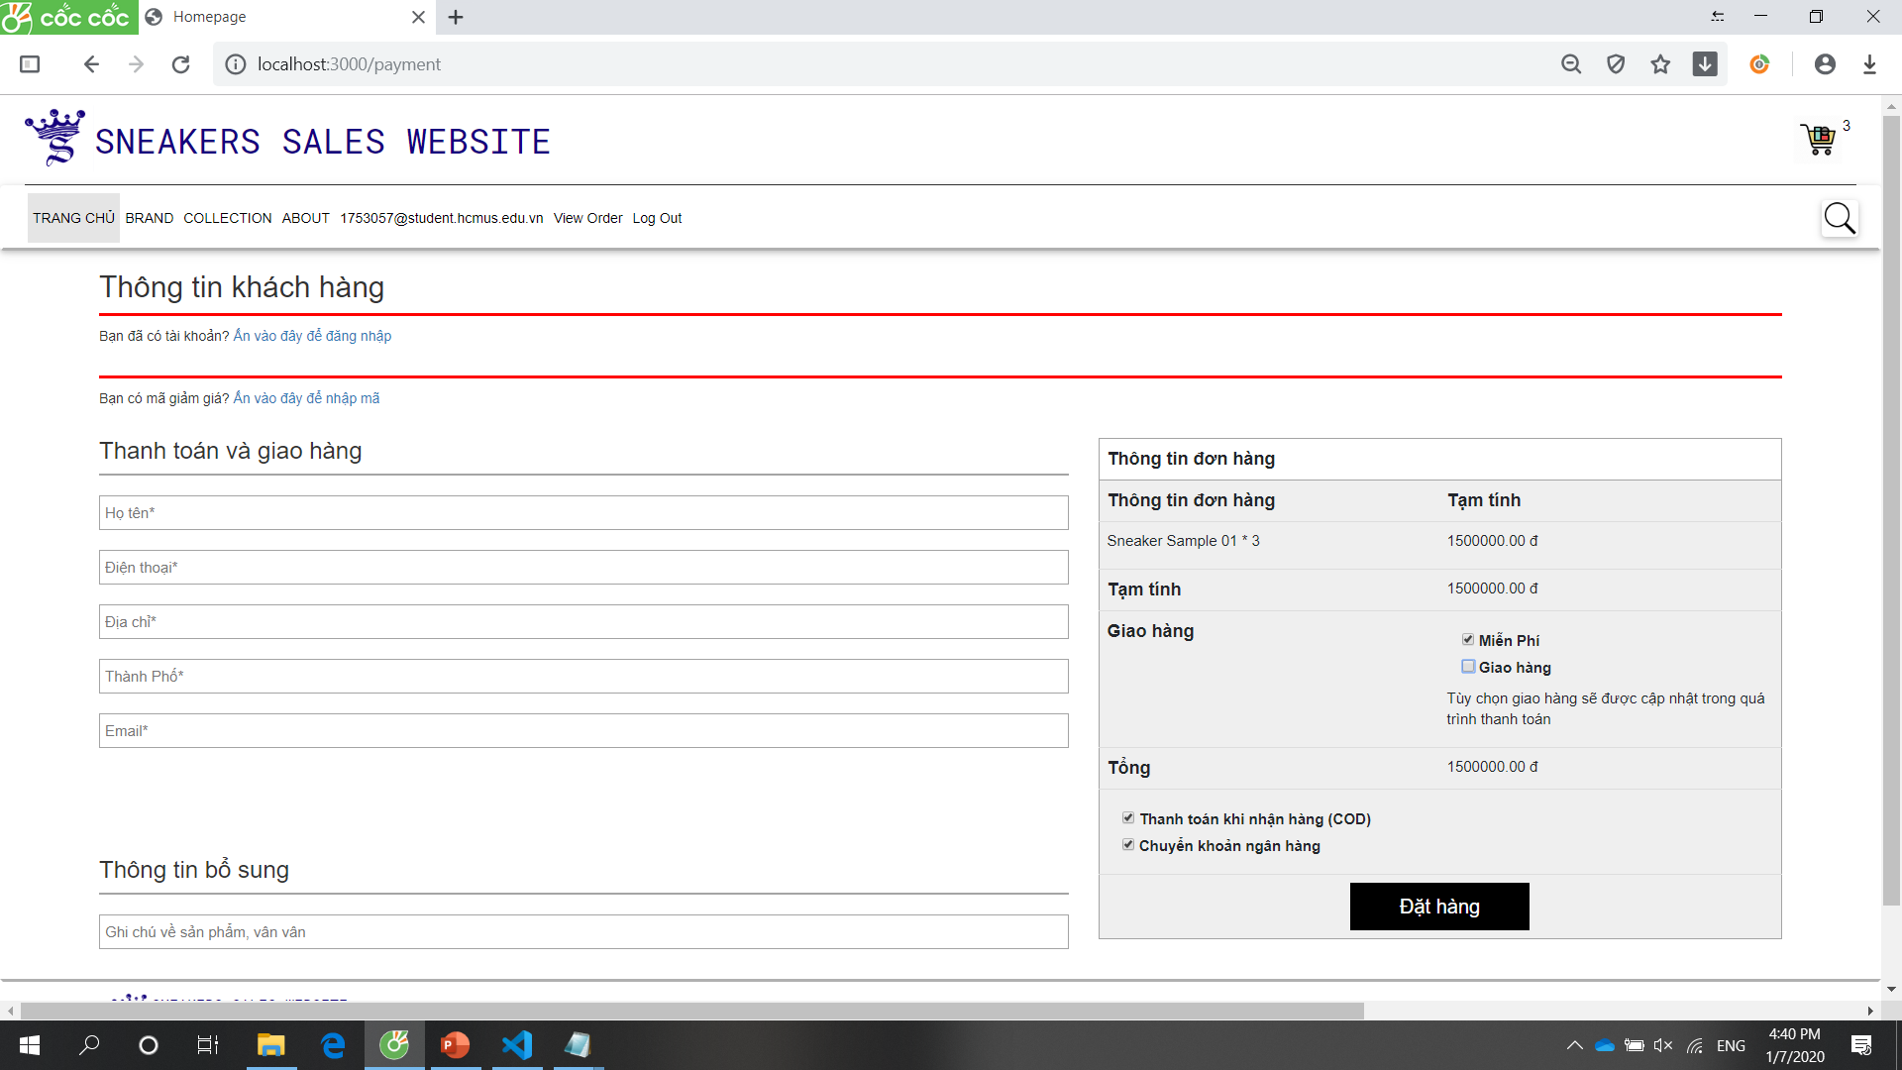
Check out

Slide 26
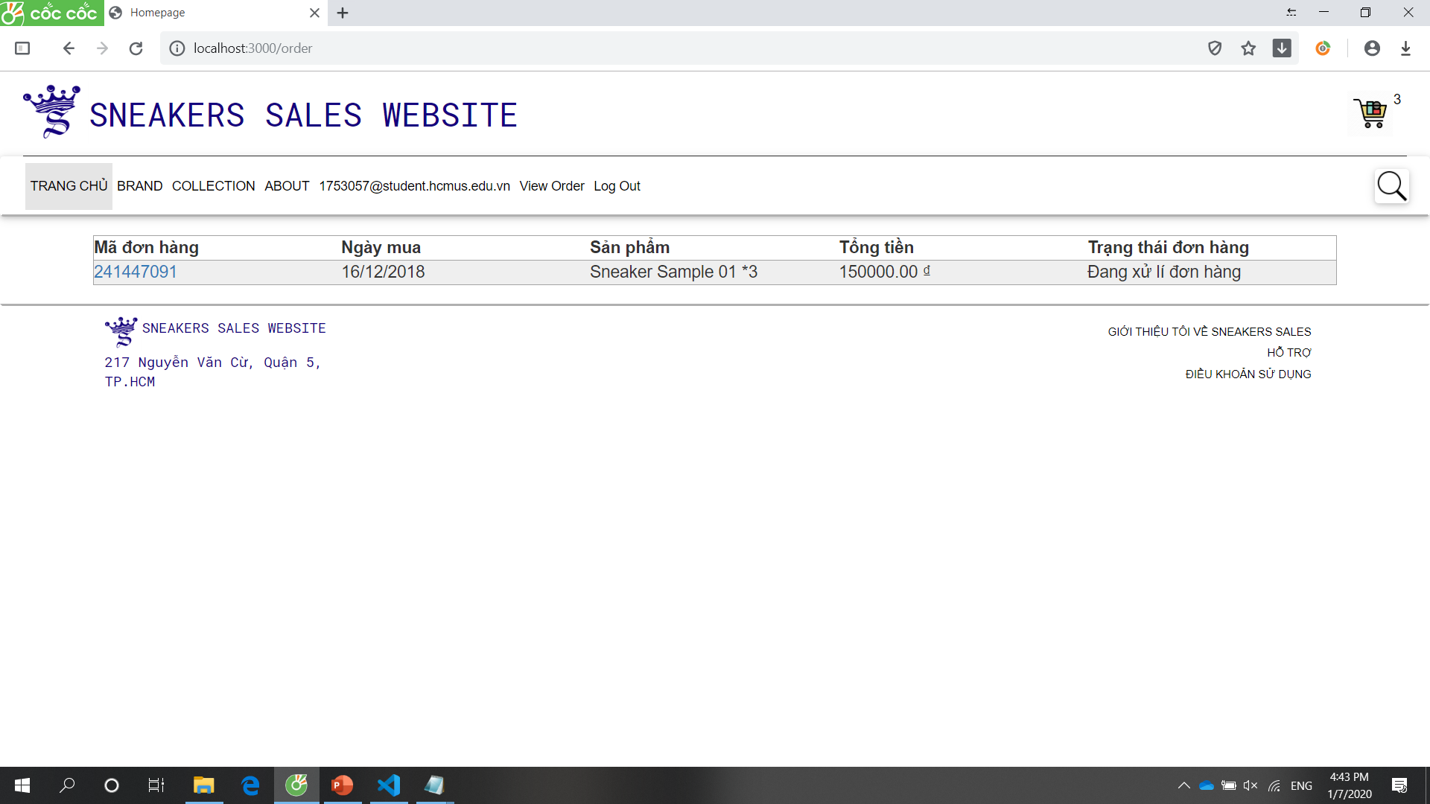
View order list

Slide 27
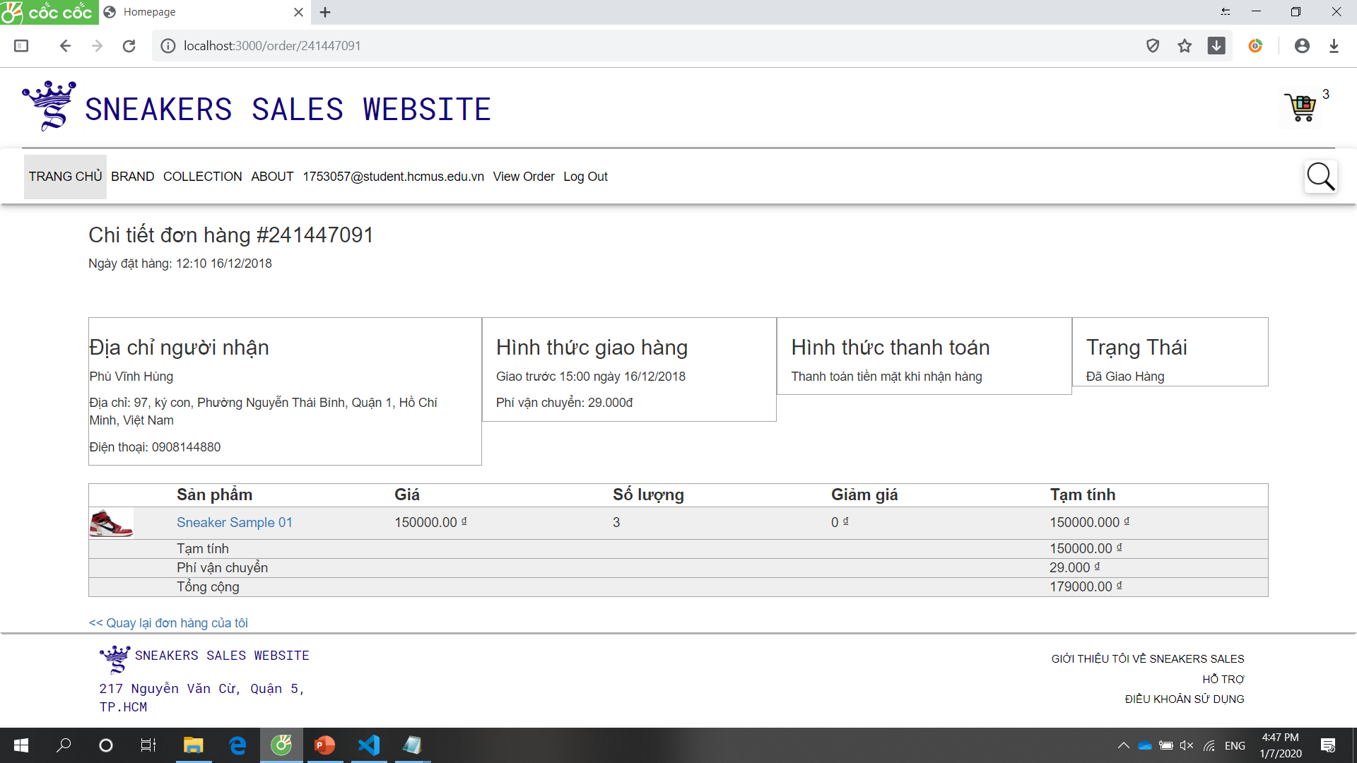
Order detail

Slide 28
Thank you for watching.

